Slide 1
Field-Effect Transistors
Topic 6 (Chapter 6)

Slide 2
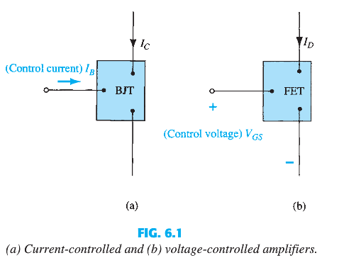
Basic Difference Between BJT and FET
The BJT is a current-controlled device
The FET is a voltage-controlled device.

Slide 3
FETs vs. BJTs
Similarities:
Both are Transistors
Amplifiers
Switching devices
3 terminal devices
Differences:
BJTs are bipolar. FETs are unipolar.
FETs are voltage controlled devices. BJTs are current controlled devices.
FETs have higher input impedance. BJTs have higher gain.
4. FETs are less sensitive to temperature variations and are better suited for integrated circuits.
5. FETs are smaller than BJTs.
6. FET have faster switching speed than BJT.

Slide 4
FET Types
JFET: Junction FET (Not in our syllabus. Not used NOW)
MOSFET: Metal–Oxide–Semiconductor FET
D-MOSFET: Depletion MOSFET
E-MOSFET: Enhancement MOSFET

Slide 5
MOSFET TYPES
Two types:
Depletion type
Enhancement type
Both of the above types have two sub-types:
N-channel or simply n-type (also called NMOS in short)
P-channel or simply p-type (also called PMOS in short)

Slide 6
Some Facts..
The name MOSFET is derived from its physical structure.
Metal Oxide Semiconductor Field Effect Transistor
However, MOSFET’s gates do not actually use any “metal”, polysilicon is used instead.
Another name for MOSFET is insulated gate FET, or IGFET.

Slide 7
ENHANCEMENT-TYPE MOSFET
E-MOSFET

Slide 8
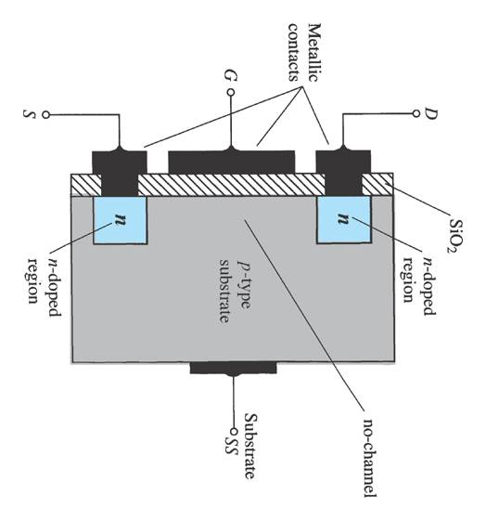
E-Type MOSFET Construction
The Drain (D) and Source (S) connect to the to n-type regions.
The Gate (G) connects to the p-type substrate via a thin insulating layer of silicon dioxide (SiO₂)
There is no channel!
The n-type material lies on a p-type substrate that may have an additional terminal connection called the Substrate (SS) or Body (B)

Slide 9
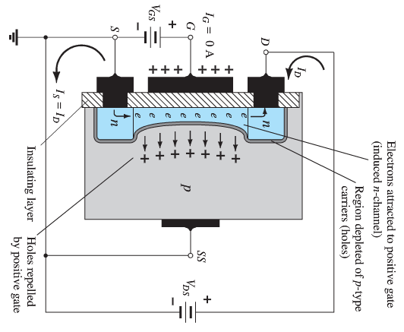
Channel formation in the n-channel enhancement-type MOSFET

Slide 10
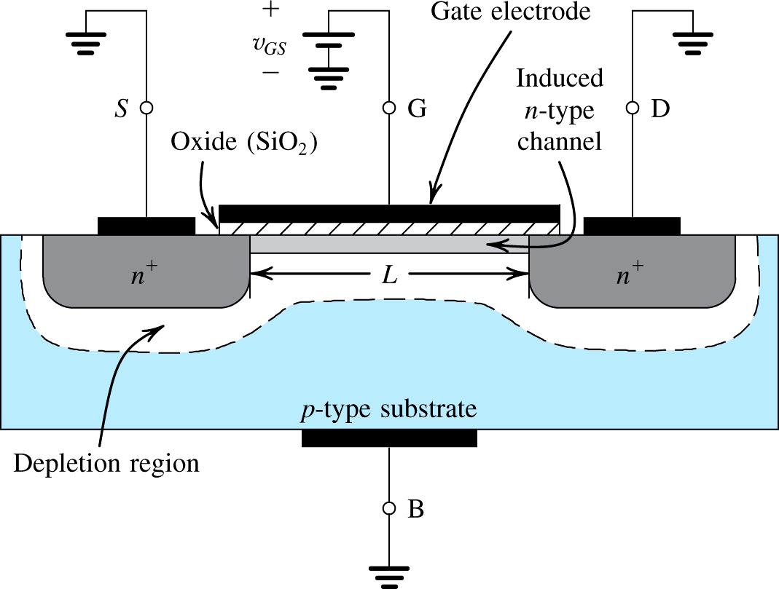
The enhancement-type NMOS transistor with a positive voltage applied to the gate
An n channel is induced at the top of the substrate beneath the gate

Slide 11

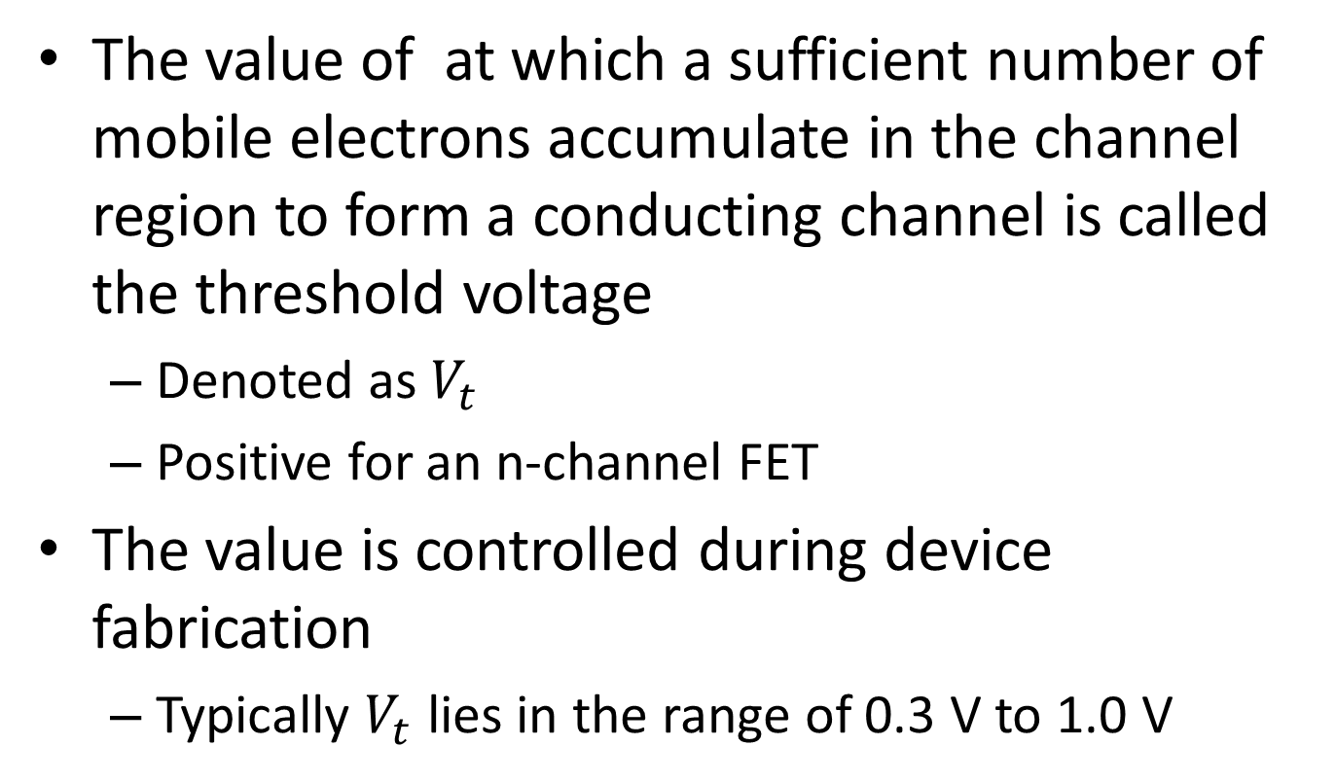
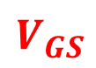
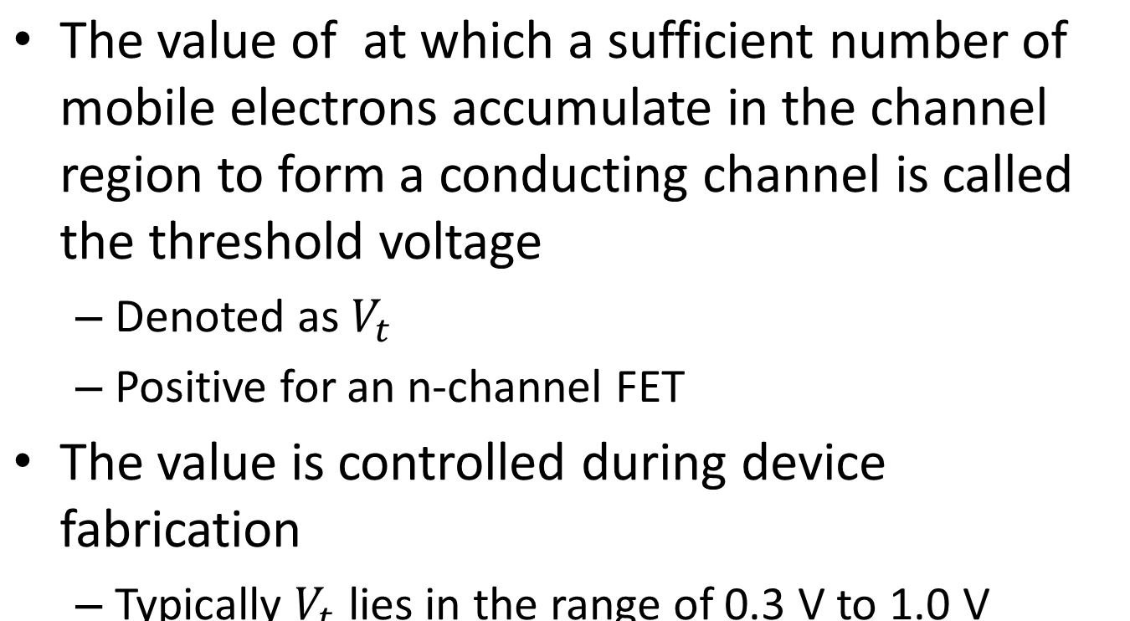
minimum
${}_{}{}_{}V$
$$V_{GS}$$

Slide 12
Field-Effect
The gate and the channel region of the MOSFET form a parallel-plate capacitor
The oxide layer acts as the capacitor dielectric
The channel conductivity and the current that flows through the channel is determined by the electric field in the channel
Caused by an applied gate voltage, v_{GS}
This is the origin of the name “field-effect transistor” (FET)
A current flows when a voltage v_{DS} is applied
Potential difference created by v_{DS}
Channel created by v_{GS}

Slide 13
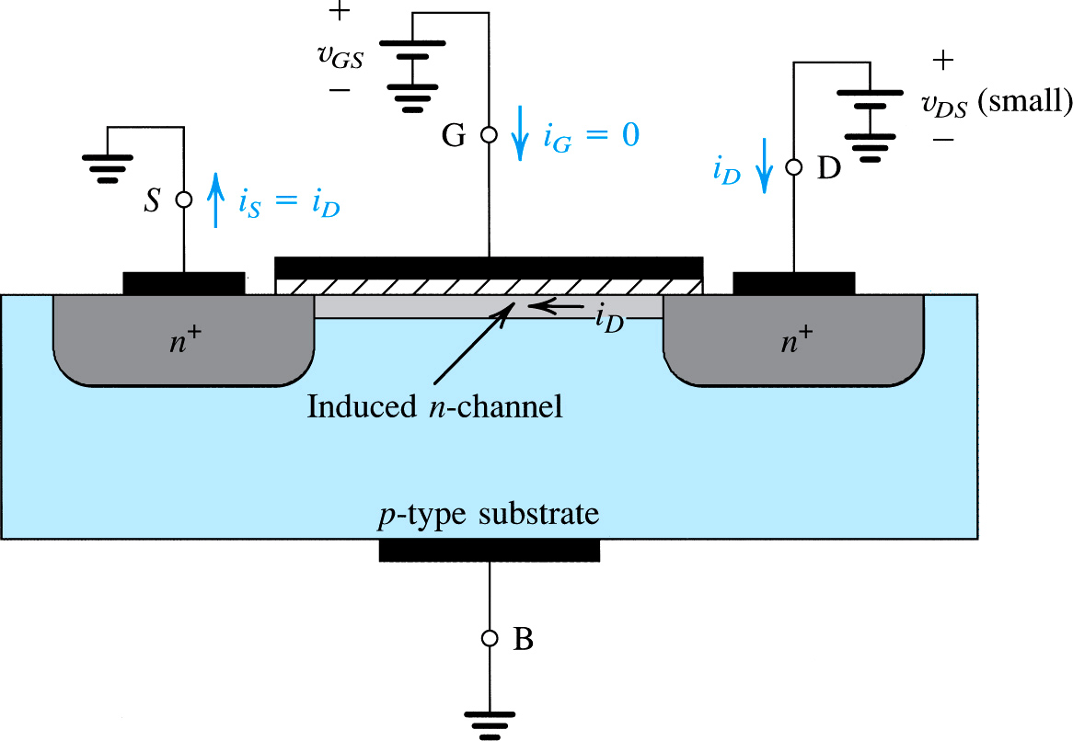
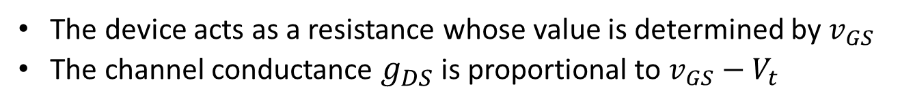
An NMOS transistor with $v_{GS}$ > $V_{t}$ and with a small $v_{DS}$ applied
The depletion region is not shown (for simplicity)

Slide 14
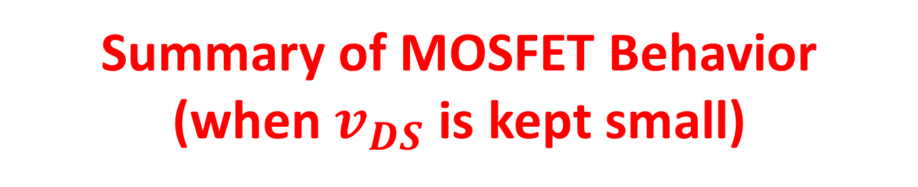
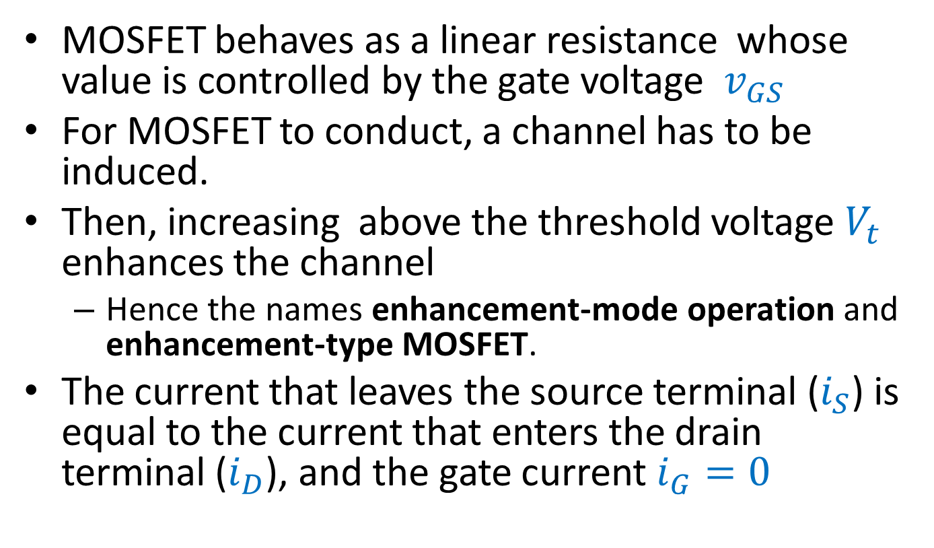

Slide 15
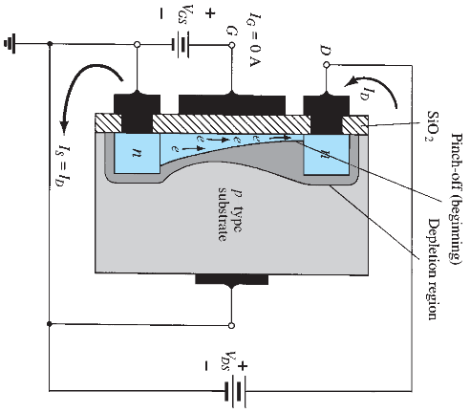
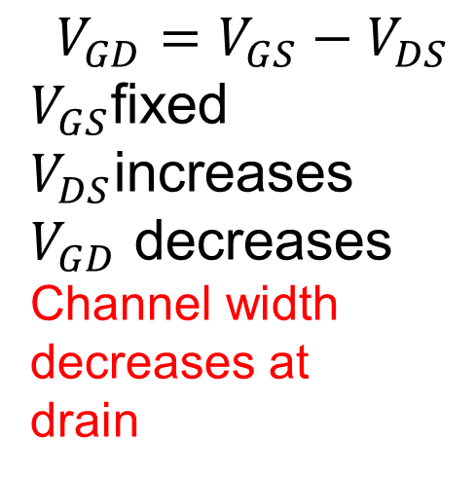
Change in channel and depletion region with V_{DS} increasing and a fixed value of V_{GS}
$$V_{GD}=V_{GS}−V_{DS}$$
$V_{GS}$fixed
$V_{DS}$increases
$V_{GD}$ decreases
Channel width
decreases at
drain

Slide 16
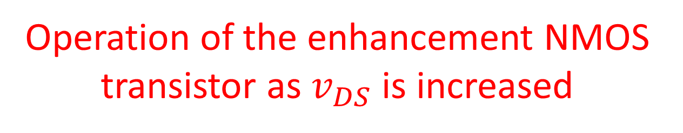
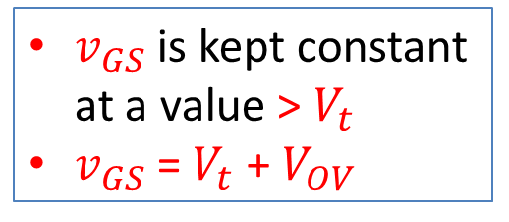
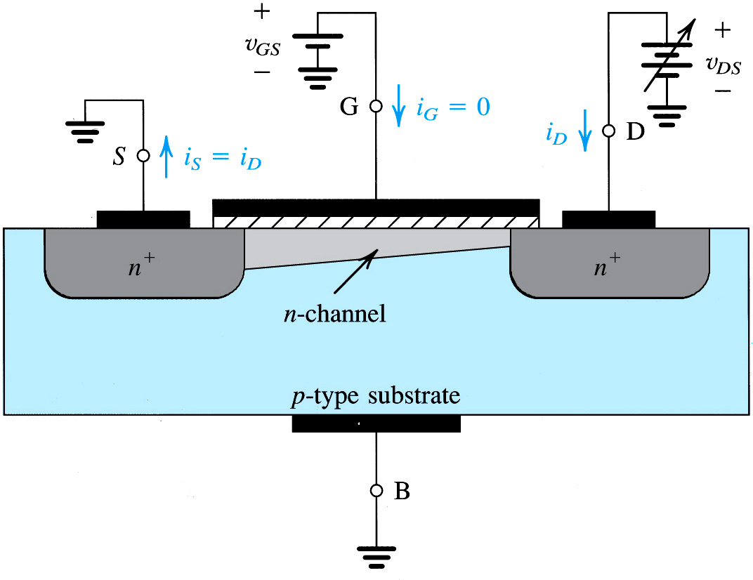
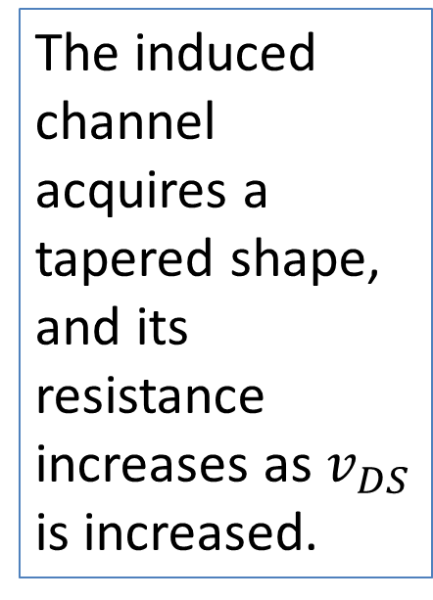

Slide 17

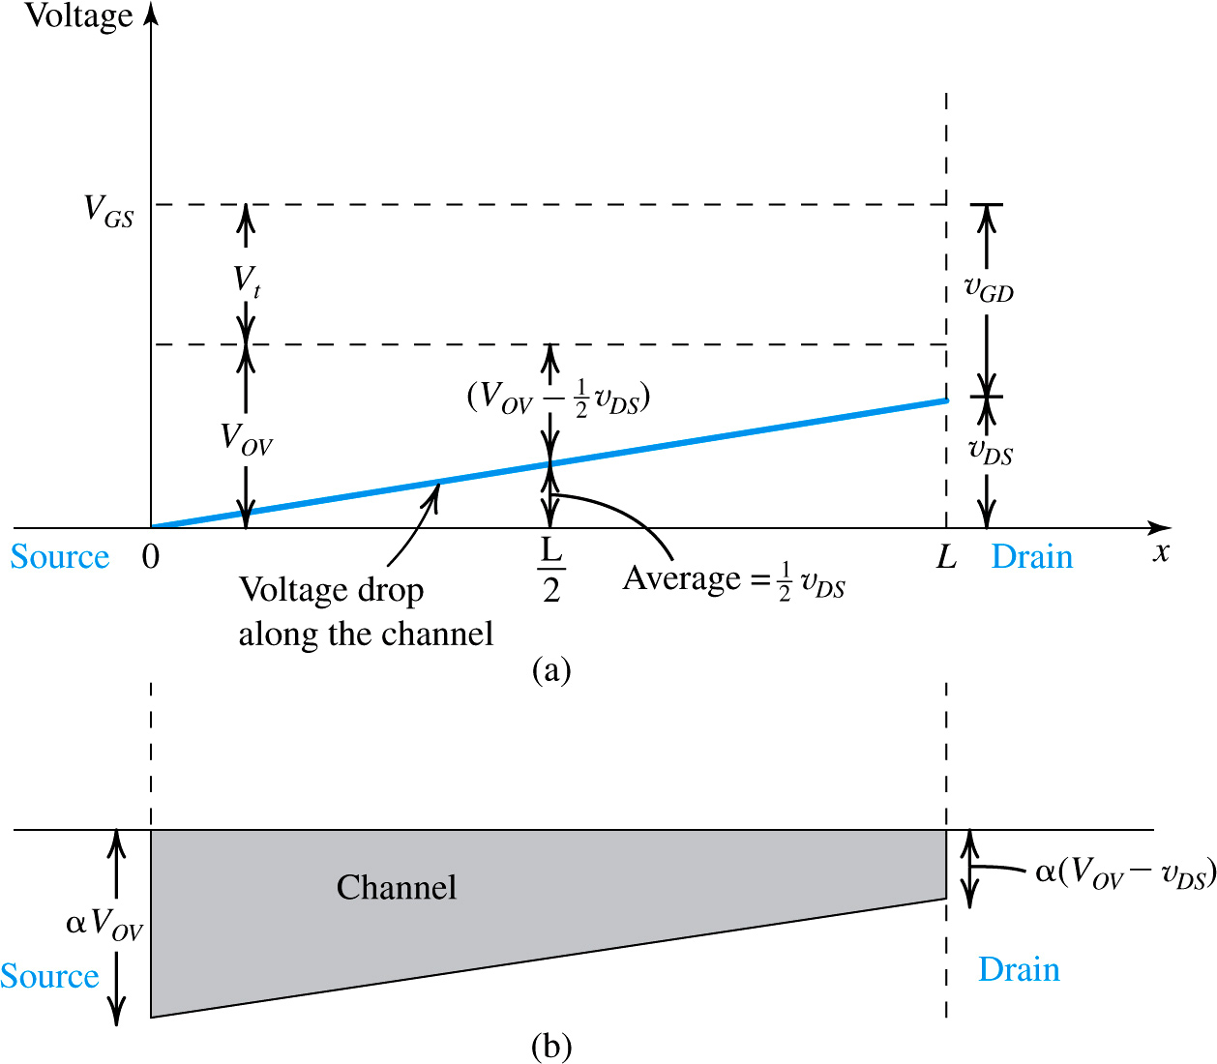

Slide 18

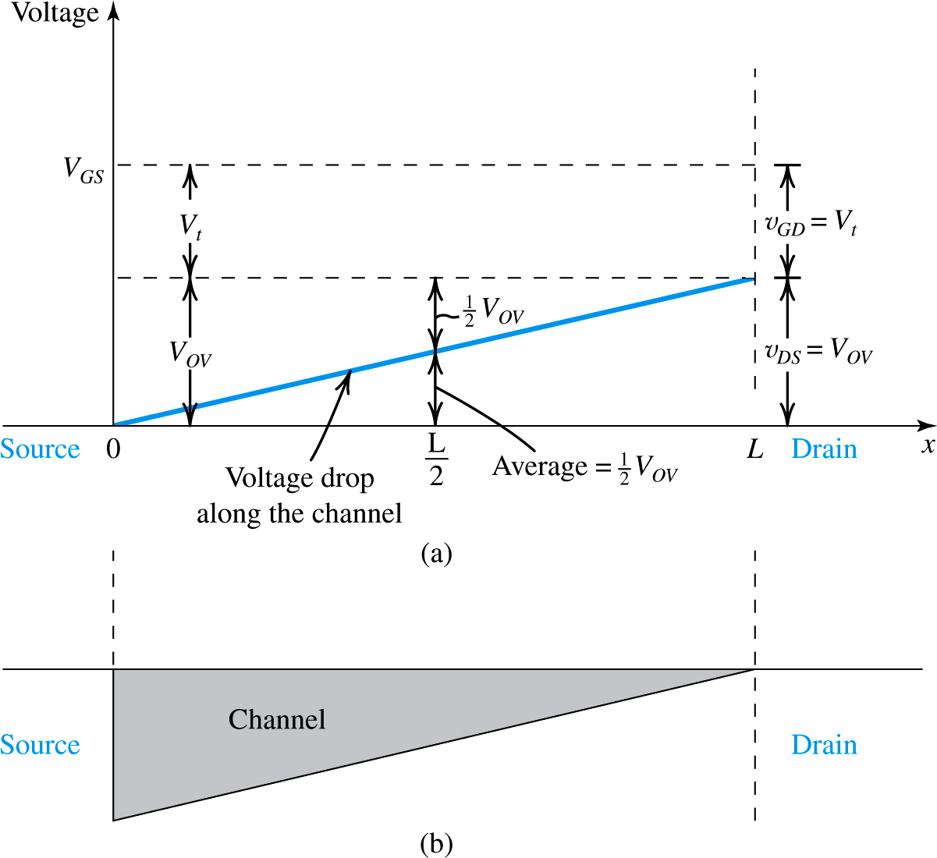
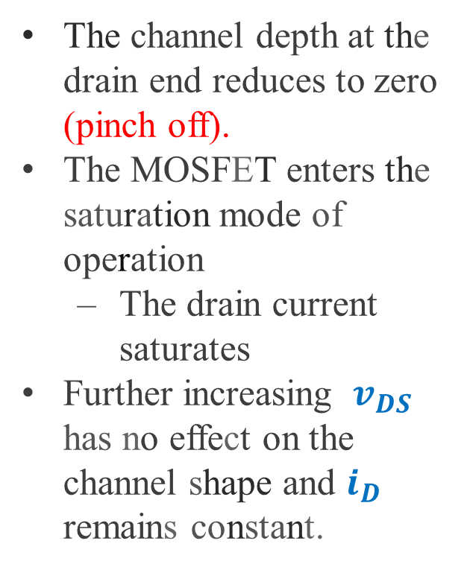

Slide 19
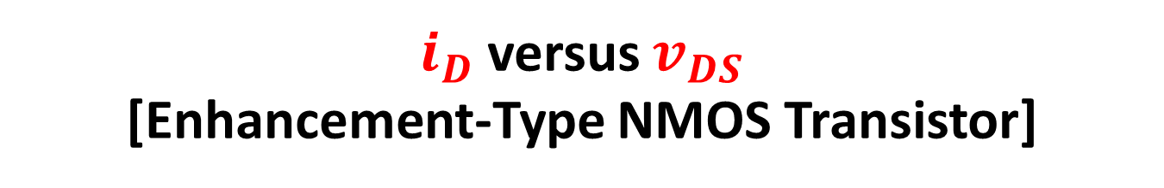
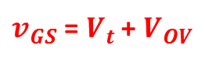
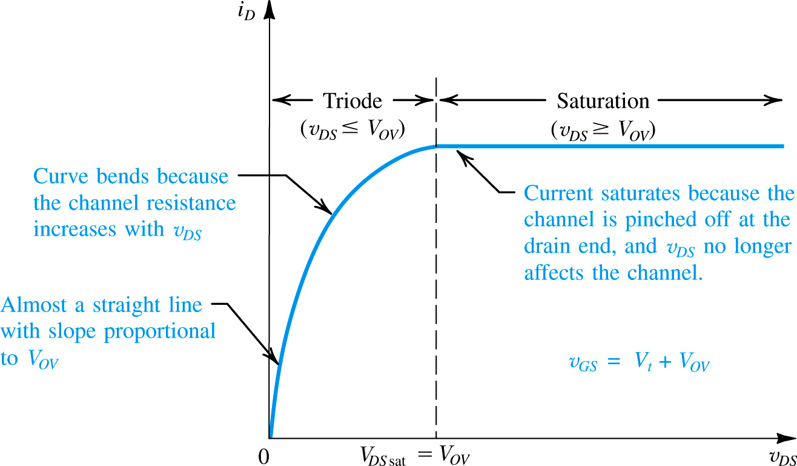

Slide 20
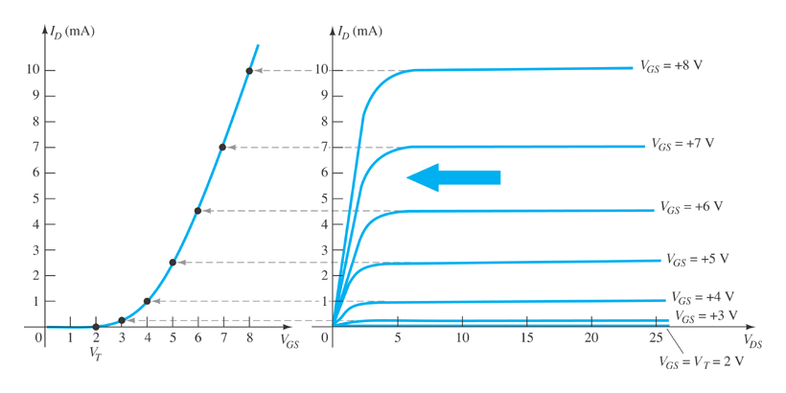
E-Type MOSFET Operation
The enhancement-type MOSFET (E-MOSFET) operates only in the enhancement mode.

Slide 21
E-Type MOSFET Transfer Curve
Where, V_{T} = the E-MOSFET threshold voltage
k, a constant, can be determined by using values at a specific point and the formula:

Slide 22
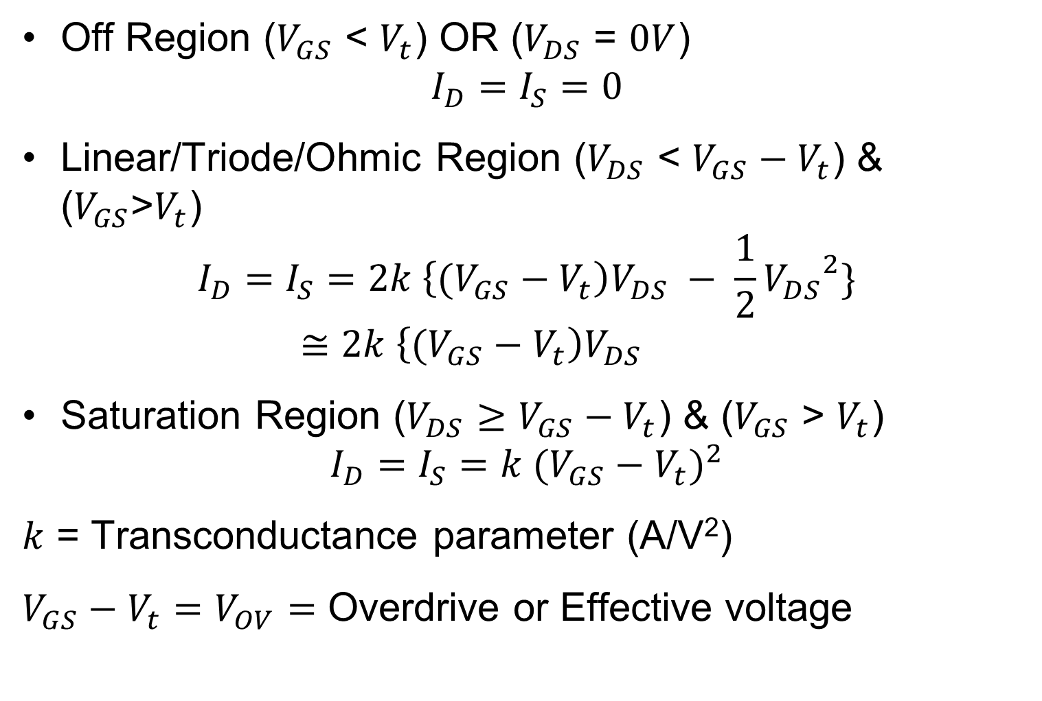
EMOSFET Current Equation
Off Region ($V_{GS}$ < $V_{t}$) OR ($V_{DS}$ = $0V$)
$$I_{D}=I_{S}=0$$
Linear/Triode/Ohmic Region ($V_{DS}$ < ${V_{GS}−V}_{t}$) & ($V_{GS}$>$V_{t}$)
$$I_{D}=I_{S}=2k \left\{\text{(}{V_{GS}−V}_{t}\right)V_{DS} − \frac{1}{2}{V_{DS}}^{2}\}≅2k \left\{\text{(}{V_{GS}−V}_{t}\right)V_{DS}$$
Saturation Region ($V_{DS}$ $≥$ ${V_{GS}−V}_{t}$) & ($V_{GS}$ > $V_{t}$)
$$I_{D}=I_{S}=k {({V_{GS}−V}_{t})}^{2}$$
$k$ = Transconductance parameter (A/V²)
${V_{GS}−V}_{t}=V_{OV}=$ Overdrive or Effective voltage

Slide 23
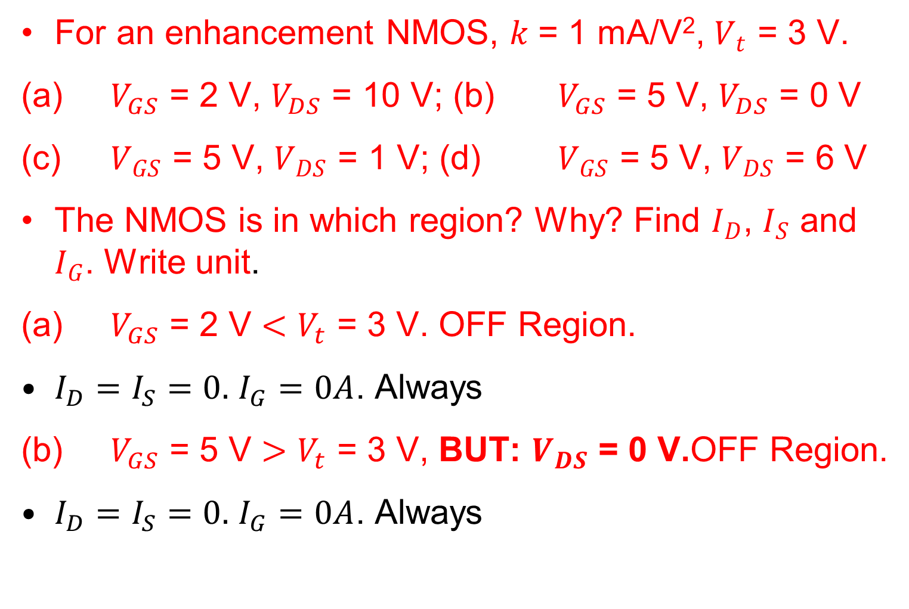
EMOSFET Current Problem
For an enhancement NMOS, $k$ = 1 mA/V², $V_{t}$ = 3 V.
(a) $V_{GS}$ = 2 V, $V_{DS}$ = 10 V; (b) $V_{GS}$ = 5 V, $V_{DS}$ = 0 V
(c) $V_{GS}$ = 5 V, $V_{DS}$ = 1 V; (d) $V_{GS}$ = 5 V, $V_{DS}$ = 6 V
The NMOS is in which region? Why? Find $I_{D}$, $I_{S}$ and $I_{G}$. Write unit.
(a) $V_{GS}$ = 2 V $<V_{t}$ = 3 V. OFF Region.
$I_{D}=I_{S}=0.$ $I_{G}=0A$. Always
(b) $V_{GS}$ = 5 V $>V_{t}$ = 3 V, BUT: $V_{DS}$ = 0 V.OFF Region.
$I_{D}=I_{S}=0.$ $I_{G}=0A$. Always

Slide 24
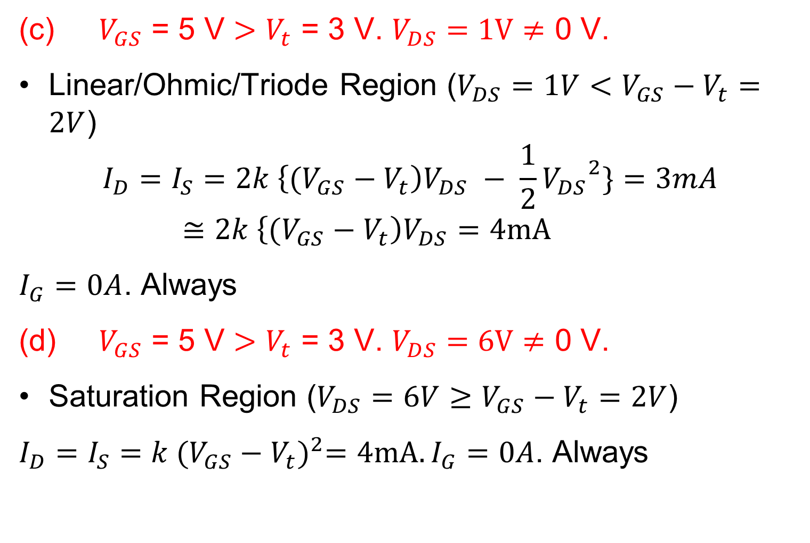
EMOSFET Current Problem
(c) $V_{GS}$ = 5 V $>V_{t}$ = 3 V. $V_{DS}$ $=1V≠$ 0 V.
Linear/Ohmic/Triode Region ($V_{DS}=1V$ $<$ ${V_{GS}−V}_{t}=2V$)
$$I_{D}=I_{S}=2k \left\{\text{(}{V_{GS}−V}_{t}\right)V_{DS} − \frac{1}{2}{V_{DS}}^{2}\}=3mA≅2k \left\{\text{(}{V_{GS}−V}_{t}\right)V_{DS}=4mA$$
$I_{G}=0A$. Always
(d) $V_{GS}$ = 5 V $>V_{t}$ = 3 V. $V_{DS}$ $=6V≠$ 0 V.
Saturation Region ($V_{DS}=6V$ $≥$ ${V_{GS}−V}_{t}=2V$)
$I_{D}=I_{S}=k {({V_{GS}−V}_{t})}^{2}=4mA. I_{G}=0A$. Always

Slide 25
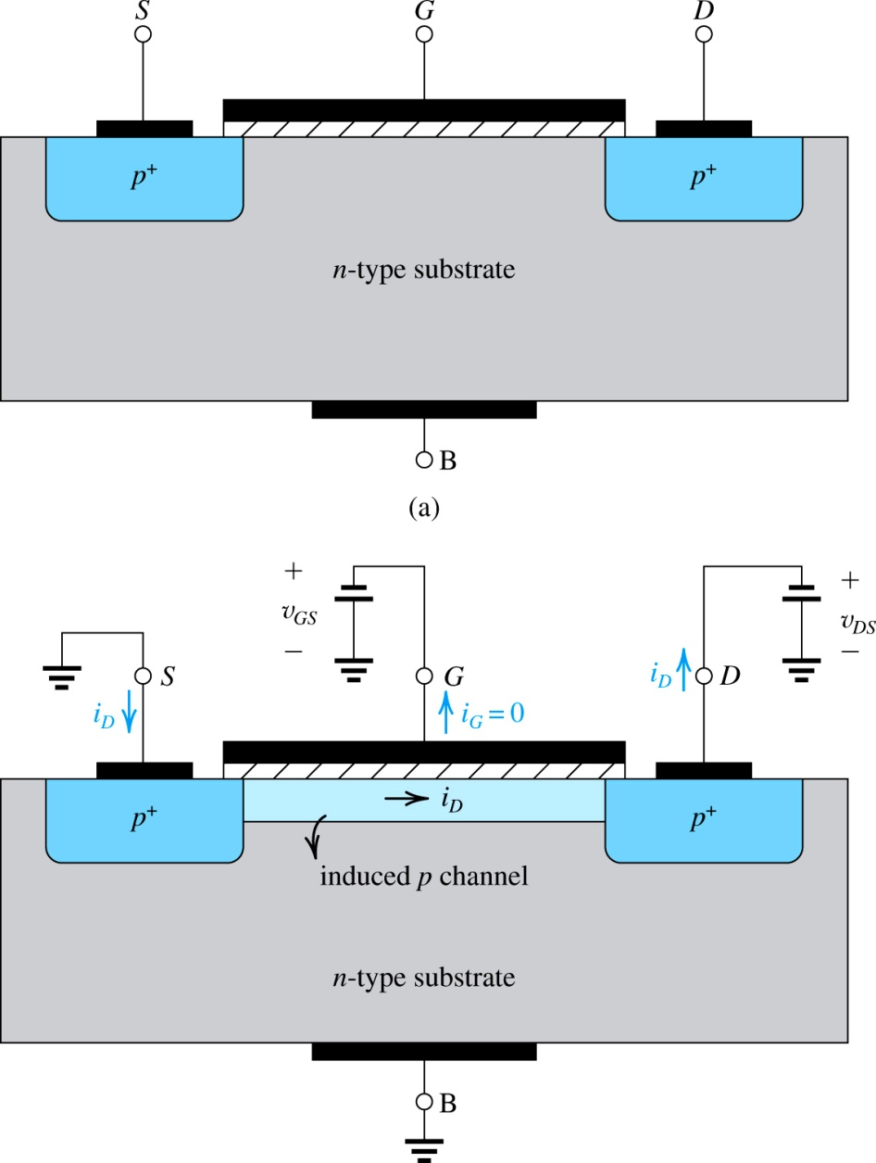
PMOS transistors Enhancement Type
Similar to the NMOS transistor
except that all semiconductor regions are reversed in polarity

Slide 26
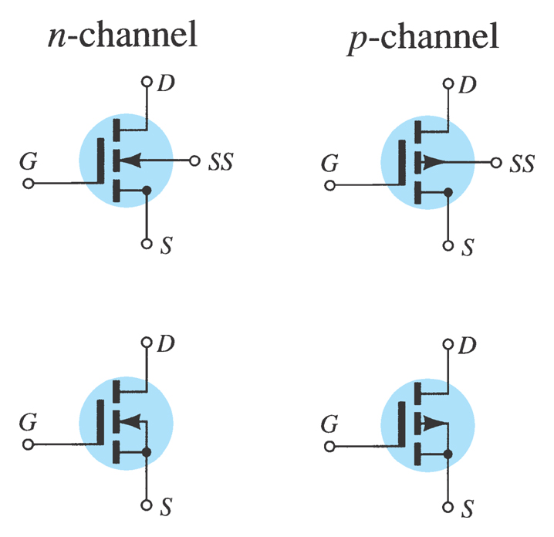
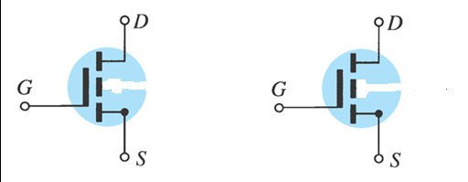
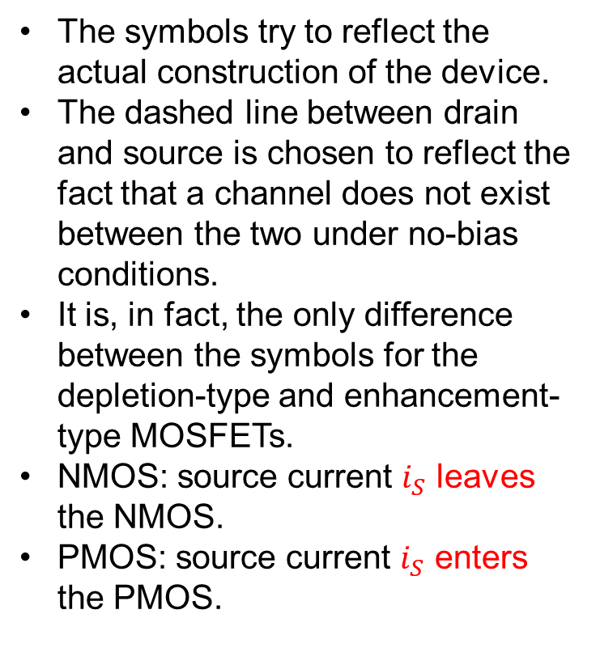
MOSFET Symbols
The symbols try to reflect the actual construction of the device.
The dashed line between drain and source is chosen to reflect the fact that a channel does not exist between the two under no-bias conditions.
It is, in fact, the only difference between the symbols for the depletion-type and enhancement-type MOSFETs.
NMOS: source current $i_{S}$ leaves the NMOS.
PMOS: source current $i_{S}$ enters the PMOS.

Slide 27
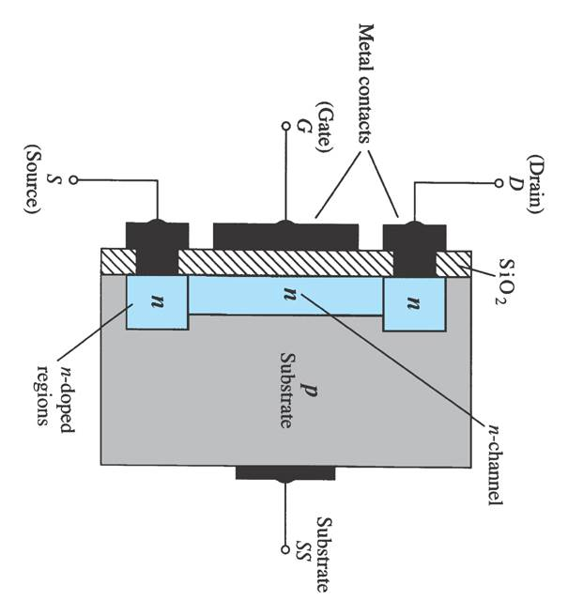
6.7 Depletion-Type MOSFET Construction
The Drain (D) and Source (S) connect to the to n-type regions.
The n-typed regions are connected via an n-channel.
The n-channel is connected to the Gate (G) via a thin insulating layer of silicon dioxide (SiO₂).
The n-type material lies on a p-type substrate or body that may have an additional terminal connection called the Substrate (SS).

Slide 28
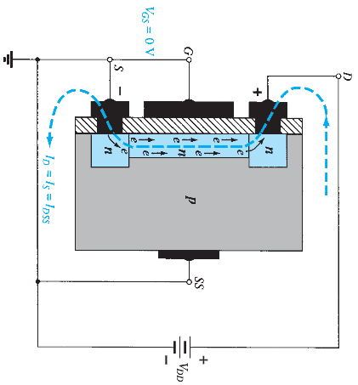
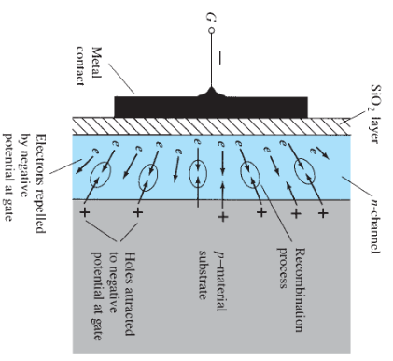
Basic Operation and Characteristics
Figure: Reduction in free carriers in a channel due to a negative potential at the gate terminal.
Figure: n-Channel depletion-type MOSFET with V_{GS} = 0 V and applied voltage V_{DD}.

Slide 29
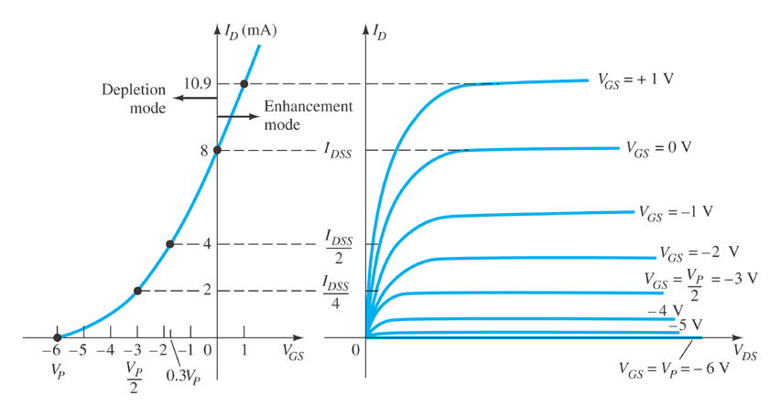
Basic MOSFET Operation
A depletion-type MOSFET can operate in two modes:
Depletion and Enhancement modes

Slide 30
Depletion Mode Operation (D-MOSFET)
When V_{GS} = 0 V, I_{D} = I_{DSS}
When V_{GS} < 0 V, I_{D} < I_{DSS}
The formula used to plot the transfer curve for a JFET applies to a D-MOSFET as well:

Slide 31
Enhancement Mode Operation
Of D-MOSFETs
V_{GS} is now positive
(I_{D} > I_{DSS})
The formula used to plot the transfer curve still applies:

Slide 32

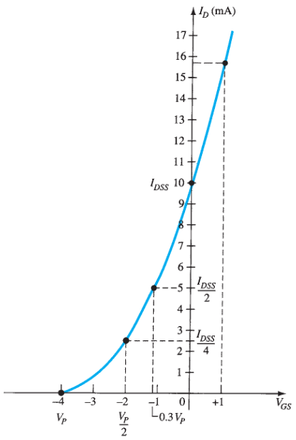
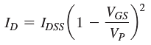

Slide 33
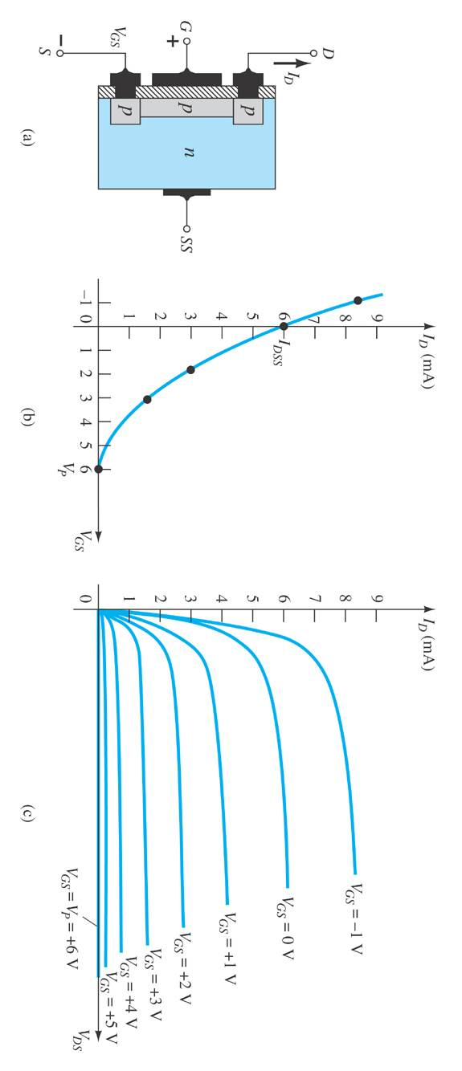
D-Type MOSFET Structures
P-channel DMOS N-channel DMOS
Same as Enhancement EMOS.
Only difference: N/P channel exists between drain and source before applying any voltage

Slide 34
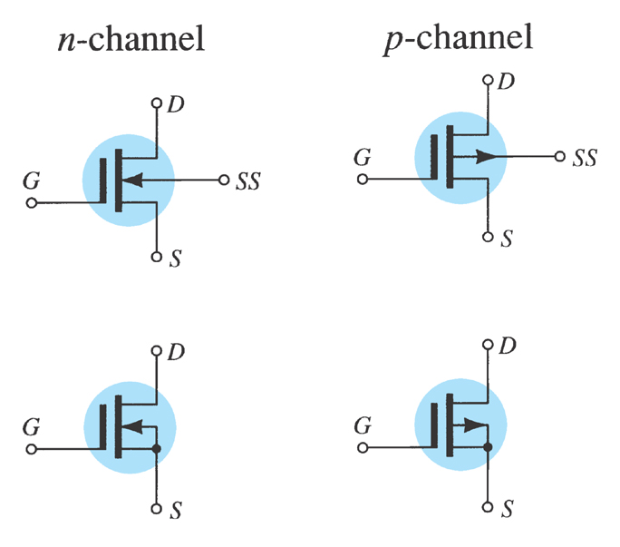
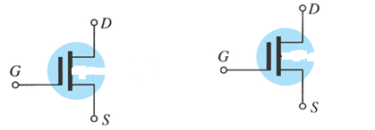
D-Type MOSFET Symbols
The symbols try to reflect the actual construction of the device.
The lack of a direct connection (due to the gate insulation) between the gate and the channel is represented by a space between the gate and the other terminals of the symbol.
The vertical line representing the channel is connected between the drain and the source and is “supported” by the substrate.
Two symbols are provided for each type of channel to reflect the fact that in some cases the substrate is externally available, whereas in others it is not.
For most of our analysis, the substrate and the source will be connected and the lower symbols will be employed.

Slide 35
JFET Characteristics
Unipolar device (one polarity of charge carrier – no minority carriers)
High input impedance
Source and drain are interchangeable in most low-frequency applications
Two diodes: gate-source and gate-drain
For normal operation the gate-source diode is reverse-biased

Slide 36
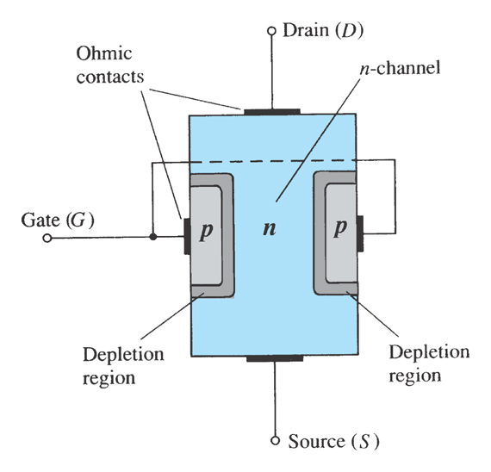
JFET Construction
There are two types of JFETs:
n-channel
p-channel
The n-channel is the more widely used of the two.

Slide 37
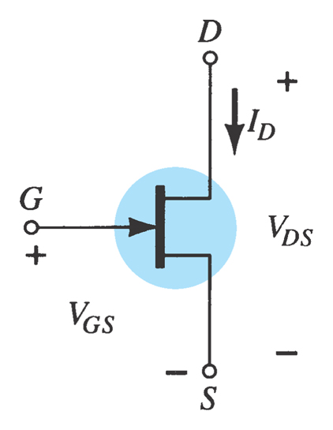
N-Channel JFET Symbol

Slide 38
JFET Operating Characteristics
There are three basic operating conditions for a JFET:
V_{GS} = 0 V (zero), V_{DS} increasing to some positive value
V_{GS} < 0 V (negative), V_{DS} at some positive value
Ohmic region: Voltage-controlled resistor

Slide 39
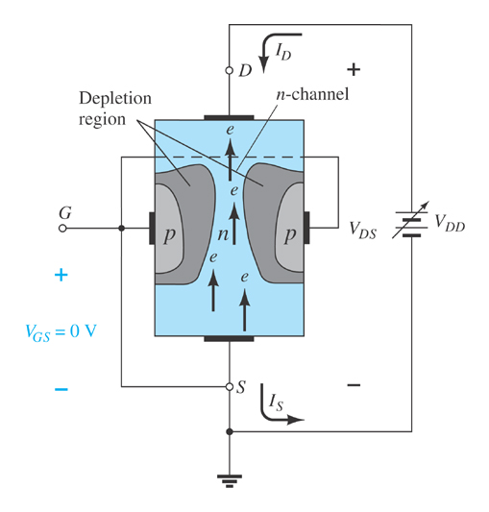
JFET Characteristics: V_{GS}=0V
Three things happen when V_{GS} = 0 V and V_{DS} increases from 0 V to a more positive voltage:
The size of the depletion region between p- type gate and n-channel increases.
Increasing the size of the depletion region decreases the width of the n-channel, which increases its resistance.
Even though the n-channel resistance is increasing, the current from source to drain (I_{D}) through the n-channel is increasing because V_{DS} is increasing.

Slide 40
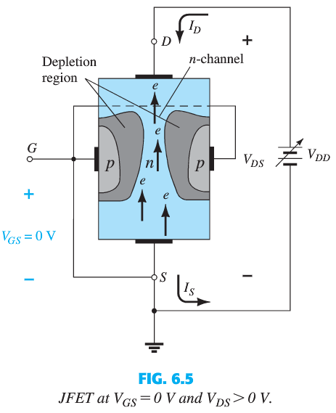
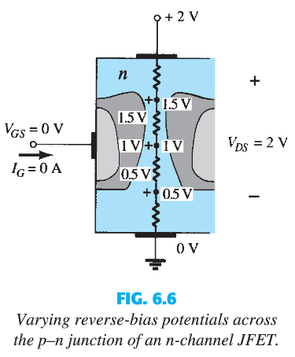
JFET Operation: V_{GS}=0V

Slide 41
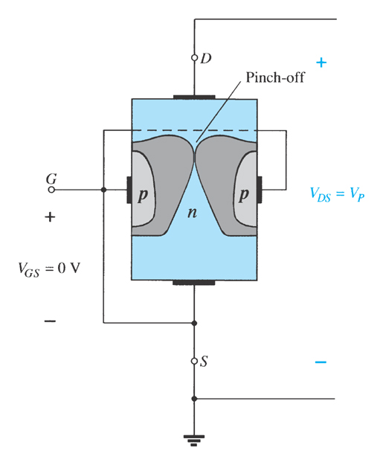
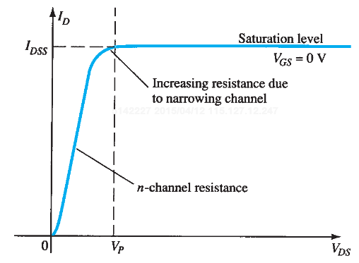
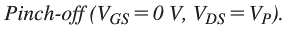
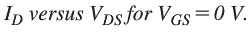
JFET Characteristics
With V_{GS} = 0 V, V_{DS} continually increases, eventually the depletion region gets so large that it pinches off the channel.
Current in channel (I_{D}) drops to 0 A.
Before pinch-off, I_{D} increases with V_{DS}.
After pinch-off, further increases in V_{DS} do not cause I_{D} to increase. It is called “Saturation”.

Slide 42
PRACTICALLY At Pinch-Off, I_{D} is Not Zero!
The term pinch-off is a misnomer in that it suggests the current I_{D} is pinched off and drops to 0A.
However, I_{D} maintains a saturation level defined as I_{DSS}
In reality, a very small channel still exists, with a current of very high density.
Why zero I_{D} is not possible at pinch-off? The absence of a drain current would remove the possibility of different potentials along the n-channel to establish the varying levels of reverse bias along the p–n junction.
The result would be a loss of the depletion region distribution that caused pinch-off in the first place.

Slide 43
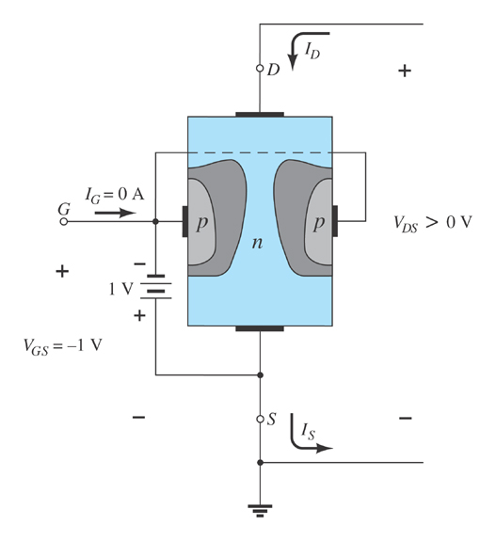
JFET Operating Characteristics,V_{GS}<0V
As V_{GS} becomes more negative, the depletion region increases.

Slide 44

JFET Operating Characteristics
As V_{GS} becomes more negative:
The JFET experiences pinch-off at a lower voltage (V_{P}).
I_{D} decreases (I_{D} < I_{DSS}) even when V_{DS} increases
I_{D} eventually drops to 0 A. The value of V_{GS} that causes this to occur is designated V_{GS(off)}.
At high levels of V_{DS,} the JFET reaches a breakdown situation. I_{D} increases uncontrollably if V_{DS} > V_{DSmax}, and the JFET is likely destroyed.

Slide 45
Voltage-Controlled Resistor
The region to the left of the pinch-off point is called the ohmic region.
The JFET can be used as a variable resistor, where V_{GS} controls the drain-source resistance (r_{d}).
A good first approximation:
As V_{GS} becomes more negative, the resistance (r_{d}) increases.

Slide 46

P-Channel JFETs
The p-channel JFET behaves the same as the n-channel JFET.
The only differences are that the voltage polarities and current directions are reversed.

Slide 47

P-Channel JFET Characteristics
As V_{GS} becomes more positive:
The JFET experiences pinch-off at a lower voltage (V_{P}).
The depletion region increases, and I_{D} decreases (I_{D} < I_{DSS})
I_{D} eventually drops to 0 A (when V_{GS} = V_{GSoff})
Also note that at high levels of V_{DS} the JFET reaches a breakdown situation: I_{D} increases uncontrollably if V_{DS} > V_{DSmax}.

Slide 48

JFET Symbols

Slide 49



JFET Operation Summary

Slide 50


JFET Transfer Characteristics
JFET input-to-output transfer characteristics are not as straightforward as they are for a BJT.
BJT: β indicates the relationship between I_{B} (input) and I_{C} (output).
JFET: The relationship of V_{GS} (input) and I_{D} (output) is a little more complicated:

Slide 51
JFET Transfer Characteristics
(Transconductance curve)
10
8
(
)
2
V_{GS}
I_{D} = I_{DSS}
1-
V_{GS(off)}
6
I_{D} in mA
4
2
0
-4
-3
-2
-1
V_{GS} in volts

Slide 52

JFET Transfer Curve

Slide 53



Slide 54




Slide 55
Complementary MOS or CMOS
Most widely used of all the IC technologies
Applies to both analog and digital circuits
CMOS is preferred over BJT in digital applications:
Less power.
Higher input impedance.
Scaling is easier

Slide 56

CMOS Devices
CMOS (complementary MOSFET) uses a p-channel and n-channel MOSFET; often on the same substrate.
Another arrangement is also possible in which an n-type body is used and the n device is formed in a p well

Slide 57

Digital Logic Inverters
Most basic element in design of digital circuits.
Figure: A logic inverter operating from a dc supply V_{DD}.

Slide 58



CMOS Logic Design: CMOS Inverter
Input 1, Output 0
Input 0, Output 1

Slide 59
FET Biasing
(We will limit our discussion to only E-MOSFET.)

Slide 64

Mathematical Vs. Graphical Approach
The relationship between input V_{GS} and output I_{D} is nonlinear, which complicates the mathematical approach to the dc analysis.
We want to design Amplifier with MOSFET
MOSFET will be in Saturation Region
Current is constant in Saturation region
$I_{D}=I_{S}=k {({V_{GS}−V}_{t})}^{2}$
A graphical approach is less accurate but quicker
We will use graphical solutions rather than mathematical solutions.

Slide 65



FET General Relationships for DC Analysis

Slide 66



Plotting The E-MOSFET Transfer Curve
Once k is defined, other levels of I_{D} can be determined for the chosen values of V_{GS}
Determining about 3 to 4 points enables drawing the device transfer characteristics.

Slide 67


Voltage-Divider Biasing
Plot the line and the transfer curve to find the Q-point using these equations:
$I_{G}$= 0; $I_{D}$= $I_{S}$

Slide 68

Voltage-Divider Bias Q-Point
(E-MOSFET)
Network: Plot the line using
V_{GS} = V_{G} , I_{D} = 0 A
I_{D} = V_{G} / R_{S} , V_{GS} = 0 V
Device: Using the following values from the spec sheet, plot the transfer curve:
V_{GSTh}, I_{D} = 0 A
V_{GS(on)} , I_{D(on)}
The point where the line and the transfer curve intersect is the Q-point.
Using the value of I_{D} at the Q-point, solve for the other circuit values.

Slide 69





Slide 70


For the NMOS below, $k=0.2 mA/V^{2}$ and $V_{t}=3V.$
Draw the device/characteristics curve and load line of the NMOS. Show the Q-point in the graph.
Find $I_{D_{Q}}$, $I_{S_{Q}}$, $I_{G_{Q}}$, $V_{{GS}_{Q}}$ and $V_{DS}$.
Step 0: Give appropriate current directions for the 3 terminals.
Step 1: Drawing Load Line from KVL at Gate-Source.
Step 2: Draw device/ characteristics curve from MOSFET current equation.
Step 3: Get $Q$-point from the intercept of Load Line and device/characteristics curve.
Step 4: Find $V_{DS}$ from KVL at Drain-Source

Slide 71

For the NMOS below, $k=0.2 mA/V^{2}$ and $V_{t}=3V.$
Draw the device/characteristics curve and load line of the NMOS. Show the Q-point in the graph.
Find $I_{D_{Q}}$, $I_{S_{Q}}$, $I_{G_{Q}}$, $V_{{GS}_{Q}}$ and $V_{DS}$.

Slide 72
For the NMOS below, $k=0.2 mA/V^{2}$ and $V_{t}=3V.$
Draw the device/characteristics curve and load line of the NMOS. Show the Q-point in the graph.
Find $I_{D_{Q}}$, $I_{S_{Q}}$, $I_{G_{Q}}$, $V_{{GS}_{Q}}$ and $V_{DS}$.

Slide 77




Step 1: Drawing Load Line from KVL at Gate-Source:
$$I_{G}=0A; I_{D}=I_{S}$$
$$−20V+0×4MΩ+0×5MΩ+V_{GS}+2kΩ×I_{S}−3V=0$$
$$V_{GS}+2kΩ×I_{D}=23$$
$$V_{GS}=0→I_{D}=\frac{23}{2kΩ}=11.5mA$$
$$I_{D}=0→V_{GS}=23V$$
$$I_{D}$$
G
$$I_{G}=0$$
$$I_{S}$$

Slide 78


Step 2: Drawing device/characteristics curve from MOSFET current equation:
$$I_{D}=I_{S}=k{(V_{GS}−V_{t})}^{2}=0.2{(V_{GS}−3)}^{2} mA$$
$$V_{GS}≤3→I_{D}=0 mA$$
$$V_{GS}=5V→I_{D}=0.2{(5−3)}^{2} =0.8 mA$$
$$V_{GS}=8V→I_{D}=0.2{(8−3)}^{2} =5 mA$$
$$V_{GS}=13V→I_{D}=0.2{(13−3)}^{2} =20 mA$$

Slide 79

$I_{D}≠11.5mA$; $V_{GS}≠23V$
$$I_{D_{Q}}=I_{S_{Q}}=7mA$$
$I_{G_{Q}}=0mA$, Always
$$V_{{GS}_{Q}}=8.75V$$

Slide 80


Step 4: Find $V_{DS}$ from KVL at Drain-Source
$$−40V+I_{D}×4kΩ+V_{DS}+2kΩ×I_{S}−3V=0$$
$$V_{DS}+6kΩ×I_{D}=43$$
We know: $I_{D_{Q}}=I_{S_{Q}}=7mA$
$$V_{DS}=43−6kΩ×7mA=1V$$

Slide 81

Special Case: If $k$ is not given. But $V_{t}=5V$ is given
Given, $I_{D}=3mA$at$V_{GS}=10V$
$$I_{D}=3 mA=k{(V_{GS}−V_{t})}^{2}$$
$$3 mA=k{(10−5)}^{2}$$
$$k=\frac{3}{{(10−5)}^{2}}=0.12 mA/V^{2}$$

Slide 82
FET Amplifiers
(We will limit our discussion to only E-MOSFET.)

Slide 83


Slide 84

E-Type MOSFET AC Equivalent
An open-circuit between gate and drain–source channel
g_{m} and r_{d} can be found in the specification sheet for the FET.

Slide 85




Determining g_{m}
The constant k can be determined from a given typical operating point on a specification sheet

Slide 86


Common-Source Voltage-Divider Bias
The input is applied to the gate and the output is taken from the drain.
There is a 180º voltage phase shift between input and output.

Slide 87
Calculations
Input impedance:
Output impedance:
Voltage gain:

Slide 88


Slide 93


Slide 94
Thank You!
It was great having you in the class!
Best of luck!

